Slide 1
Enrollment
Procedure

Slide 2
Error!
Please Follow the On-Screen
Instructions to Continue
Go Back

Slide 3
Complete
Please navigate to the next module
Within this course to continue
Start Over

Slide 4
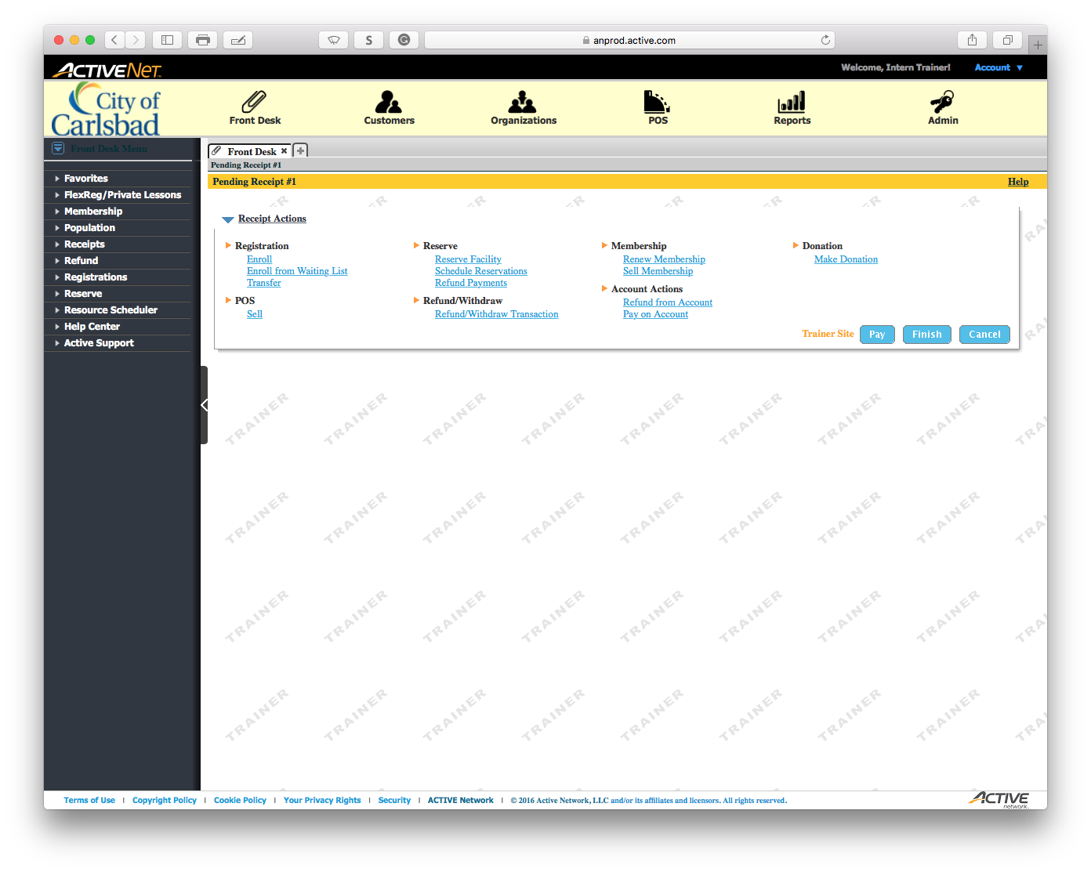
Main Text Instruction Will Go Here
Sub Instruction Here

